Slide 1

Adidas Sales U.S Report Analysis
Microsoft Excel

Slide 2
Overview Dataset Adidas Sales
Introduction:
Briefly introduce Adidas as a leading sportswear brand.
Highlight the importance of sales data in driving business decisions.
Introduce the Adidas Sales Report Revenue as a key source of insights.
Key Performance Indicators (KPIs):
Overall Revenue.
Regional Performance.
Product Category Performance.
Channel Performance.
A dataset from Adidas Sales in United State by Heemali Chaudarri provides a recap of sales from 2020 to 2021. This data was collected from the Kaggle website.
to analyze sales to determine the sales performance each month per year and encompassing analyses from sales revenue per year

Slide 3

$897.717.375
Total revenue that was collected from all stores retailer and all regions

Slide 4

Sum of Total Sales | Column Labels
Row Labels | Amazon | Foot Locker | Kohl's | Sports Direct | Walmart | West Gear | Grand Total
Midwest | $14.651.123 | $47.987.394 | $22.229.415 | $26.207.191 |  | $22.540.586 | $133.615.709
Northeast | $36.262.590 | $65.326.474 | $14.031.168 | $24.698.097 | $13.712.005 | $32.293.733 | $186.324.067
South | $409.091 | $9.307.025 | $3.552.055 | $65.258.121 | $33.049.858 | $33.087.031 | $144.663.181
Southeast | $10.826.333 | $59.669.118 |  | $54.178.543 | $21.005.539 | $17.491.703 | $163.171.236
West | $13.365.025 | $37.804.709 | $62.302.115 | $12.129.045 | $6.791.008 | $137.551.280 | $269.943.182
Grand Total | $75.514.162 | $220.094.720 | $102.114.753 | $182.470.997 | $74.558.410 | $242.964.333 | $897.717.375
Insights
The West has the highest total sales at $269,943,182. This suggests that stores in the West are more productive than stores in other regions. This could be due to factors like: Higher concentration of outdoor enthusiasts who tend to buy more sportswear and presence of a large tech industry with high-paying jobs, leading to higher disposable income.
The Midwest has the lowest total sales at $133,615,709. This suggests that Walmart is a more important sales channel for Adidas in the Midwest compared to other regions. This could be due to factors like: Walmart's strong presence in the region, with many stores located in rural and suburban areas.

Slide 5
Total Sales by Retailer and Region

Slide 6
Daily Sales / Revenue by Year
Conclusion
The most significant increase in revenue appears to be between Q4 2020 and Q1 2021, potentially due to seasonal factors or post-holiday buying trends.
The average monthly revenue across the entire period is approximately $59.8 million.
The highest total revenue figure is $78,334,681, achieved in November 2021 and The lowest total revenue figure is $45,622,165, recorded in March 2020.

Slide 7

Total Profit Earn by Sales Method
Sum of Operating Profit
Row Labels | Midwest | Northeast | South | Southeast | West | Grand Total
In-store | $23.165.650 | $42.544.200 | $1.348.000 | $25.582.563 | $34.950.875 | $127.591.288
Online | $14.660.696 | $2.246.832 | $23.993.943 | $32.693.515 | $22.076.352 | $95.671.339
Outlet | $14.101.163 | $23.229.556 | $35.796.061 | $2.279.339 | $32.582.179 | $107.988.297
Grand Total | $51.927.509 | $68.020.588 | $61.138.004 | $60.555.417 | $89.609.407 | $331.250.924

Slide 8


Total Earn
$331.250.924
2.471.791
58%
Total profit that Adidas was collected
Total unit sold that Adidas sells
Percentage profit from all total sales/revenue

Slide 9
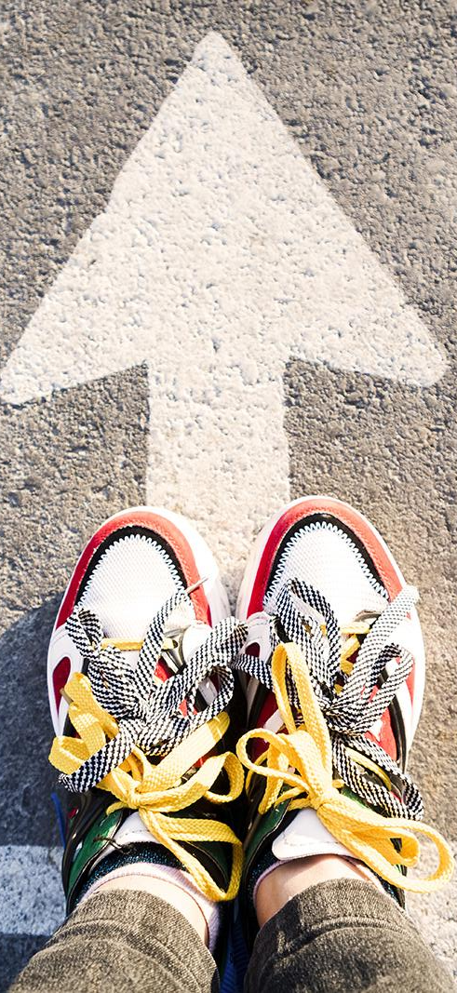
Units Sold by Product
* Men’s Street Footwear has the most
units sold by Year with total sold 591825
Product

Slide 10

Forcest Sales Prediction
Summary
Sales are predicted to continue increasing in the coming months, with the forecast exceeding the upper confidence bound in November and December 2023.
The growth rate is predicted to accelerate in the near future, with the forecast diverging more significantly from the historical data.
There is a high degree of uncertainty around the predictions, as indicated by the wide confidence bounds. This could be due to a number of factors, such as economic conditions, changes in consumer preferences, or competitor activity.

Slide 11

THANKS
Do you have any questions?
Please keep this slide for attribution

